Slide 1
Phonics Memory Game

Slide 2
Choose one to start!
Easy
Moderation
Hard

Slide 3




Slide 4
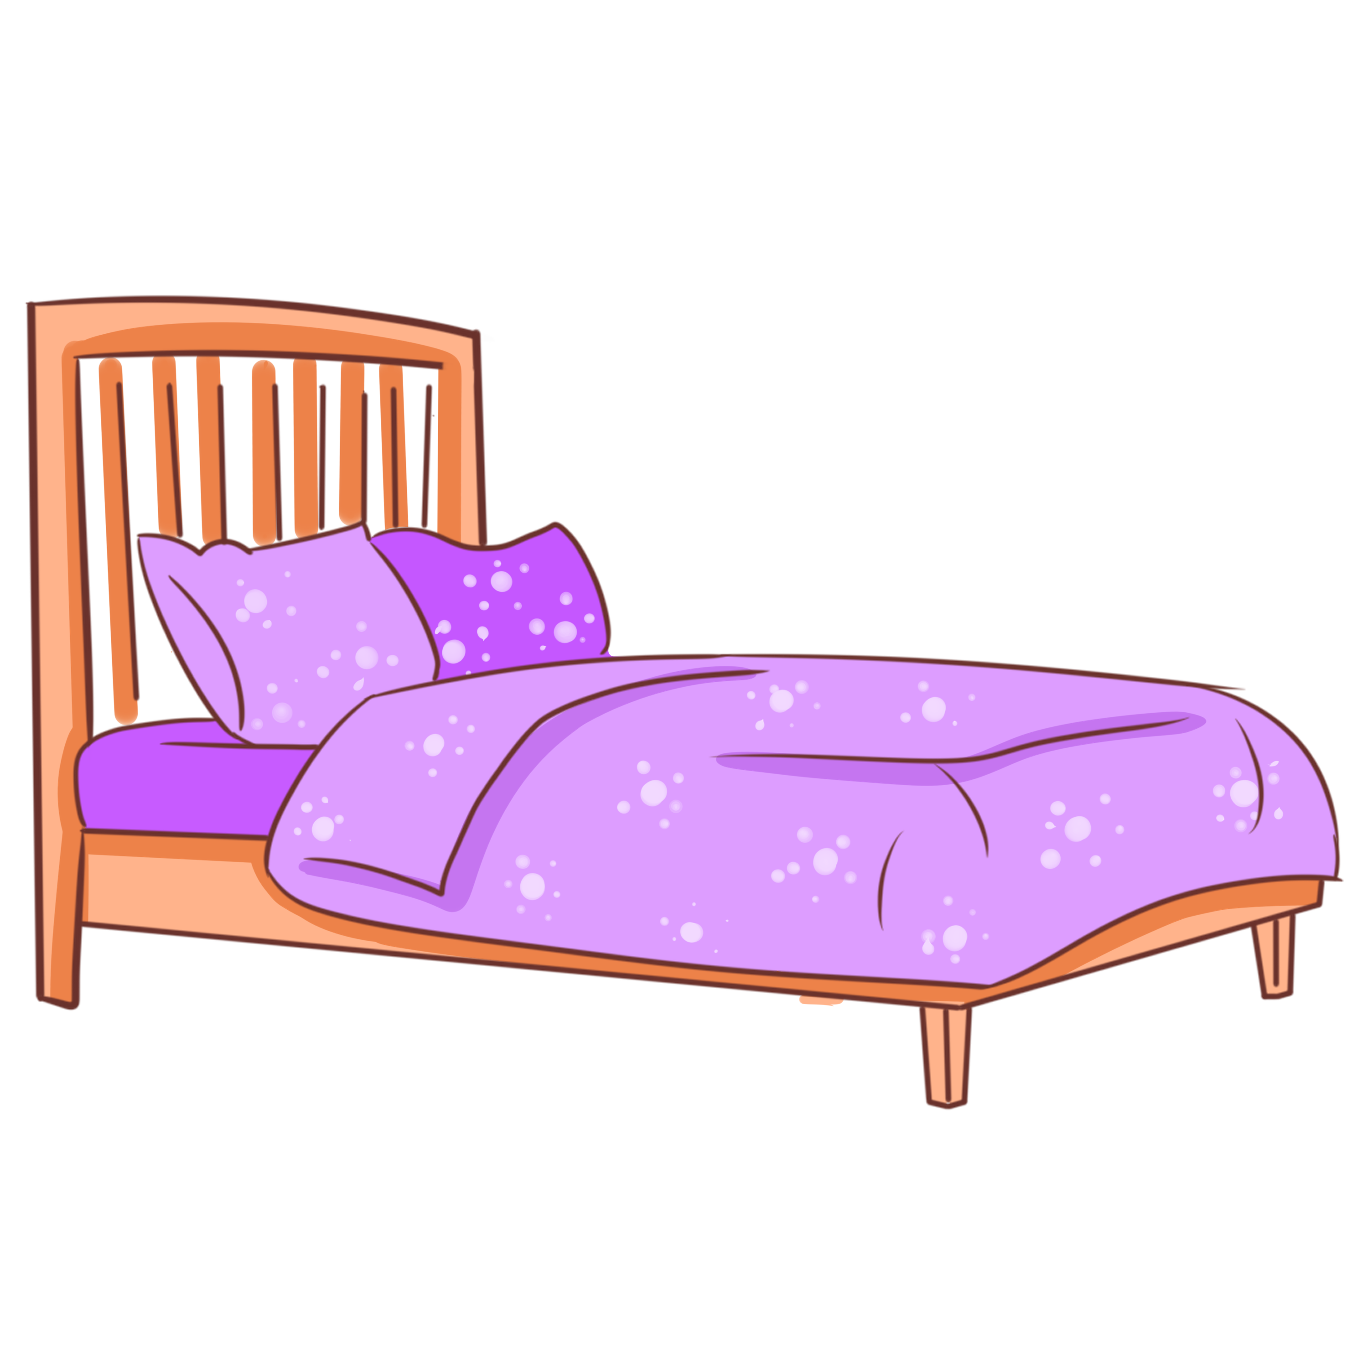


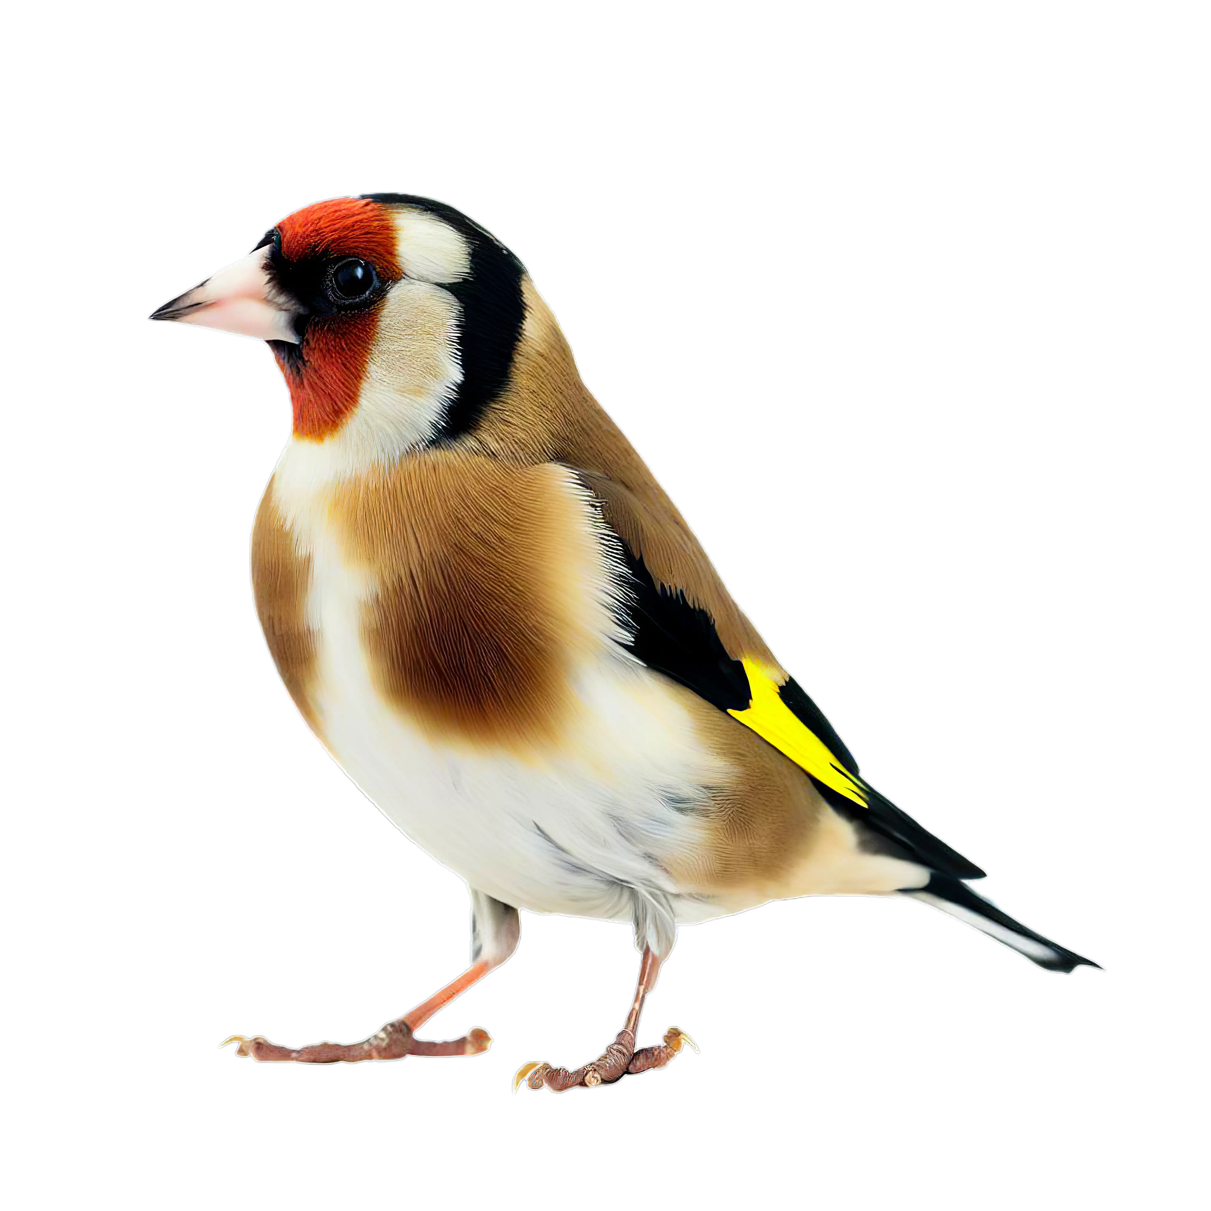


A
bed
nail
B
C
D
E
bird
F
G
pig
H
reset
swim
I
J
K
L
ball

Slide 6


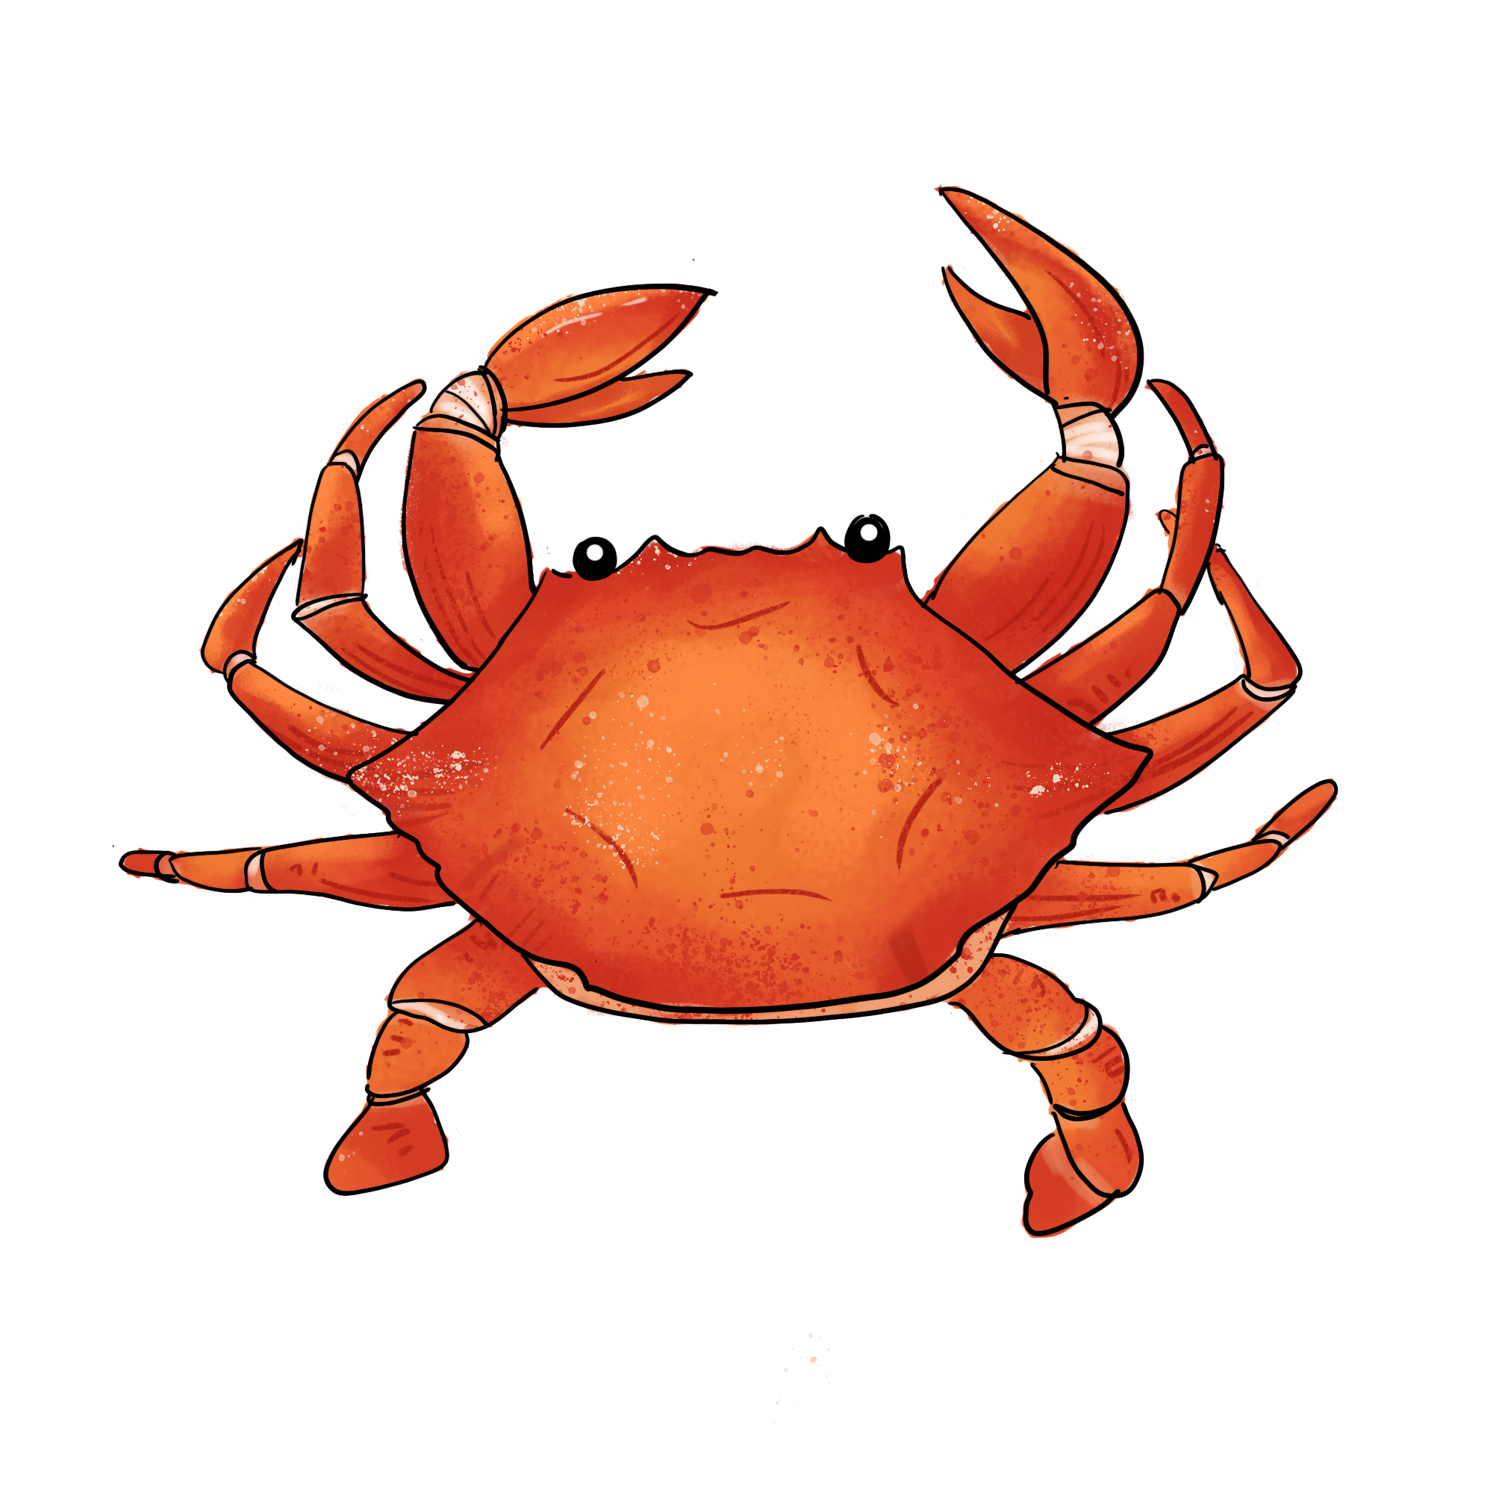

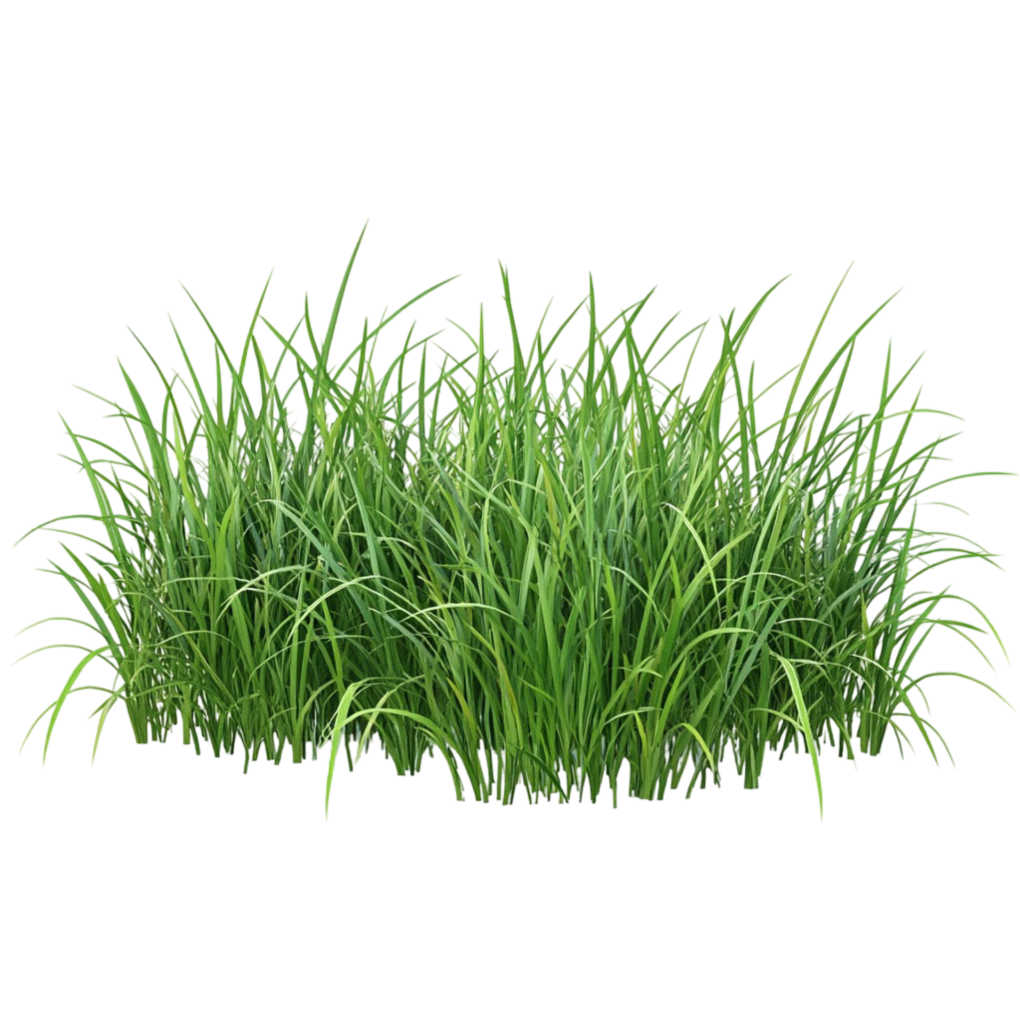
grass
D
A
B
March
C
crab
G
E
F
yellow
H
reset
blood
K
park
I
J
L

Slide 8
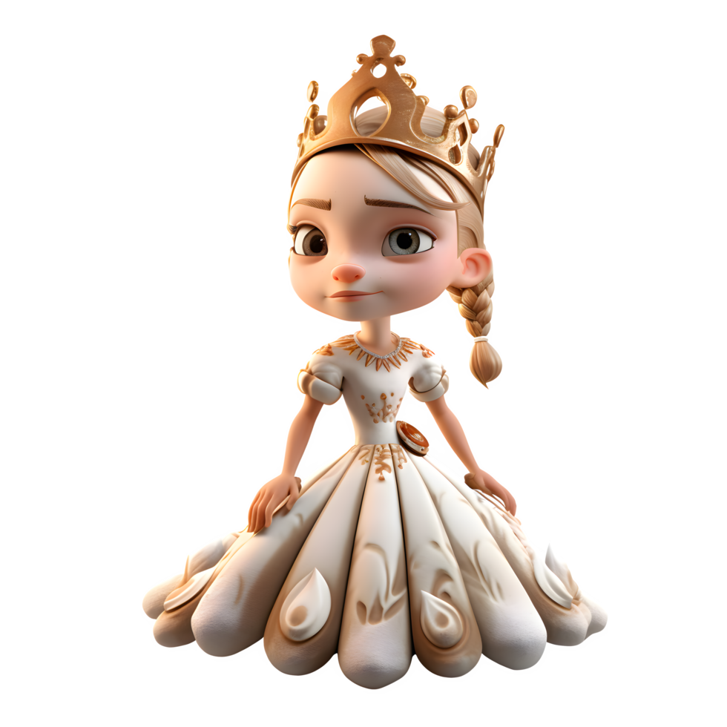





grape
jacket
C
A
B
D
bridge
nice
E
F
G
H
reset
slept
K
L
I
J
queen

Slide 9
Introduction
This is a phonics review memory matching game.
There are two things under the squares – pictures & words.
  Words – for students to tap and read.
  Pictures – for matching.
Teachers should play and know it well before using it in class.

Slide 10
How to play?
Choose the level to start.
Select any yellow square to start.
Find a match word/picture.
  Not found the pair – choose them again to restart.
  Found the pair – keep going to the next pair.
  If there are too many mistakes, choose “reset” to restart.
Choose “reset” to restart the game.
Tap the little house at the corner to return to the level page.

Slide 11
Instructions for teachers
Change words/letters/background colors – Change it directly.
Change pictures – Move the cover away. Then go “shape format” → “shape fill” → “picture”.
Enjoy the game in class!

